Slide 1

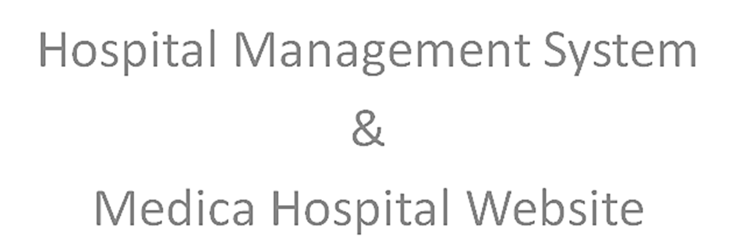
(Graduation Project)
Prof.Dr. Benjamin Duraković, Graduation Project Coordinator
Prof. Dr. Emine Yaman, Graduation Project Supervisor Hana Hadžo Mulalić, CS Student

Slide 2
Hospital Management System Purpose;
Large data amount: employees, patients, rooms, billing, records;
Manual Management System ploblems:
Data duplicaton
Large storage costs
Data retrieval, editing, deletion, read
Data insecurity & lost
Slowness

Slide 3
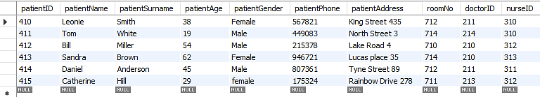
Hospital Database Management System;
MySQL Software;
SELECT * FROM hospital_management.patient;

Slide 4

“Medica” Hospital Website benefits:
To provide the website visitors with important hospital information;
To increase patient convenience, satisfaction, loyalty;
To improve hospital brand in a way that supports the goals;
To provide the website users to be in touch with the hospital;
To attrack new potential patients;

Slide 5
Thank you for attention !
?

